Slide 1
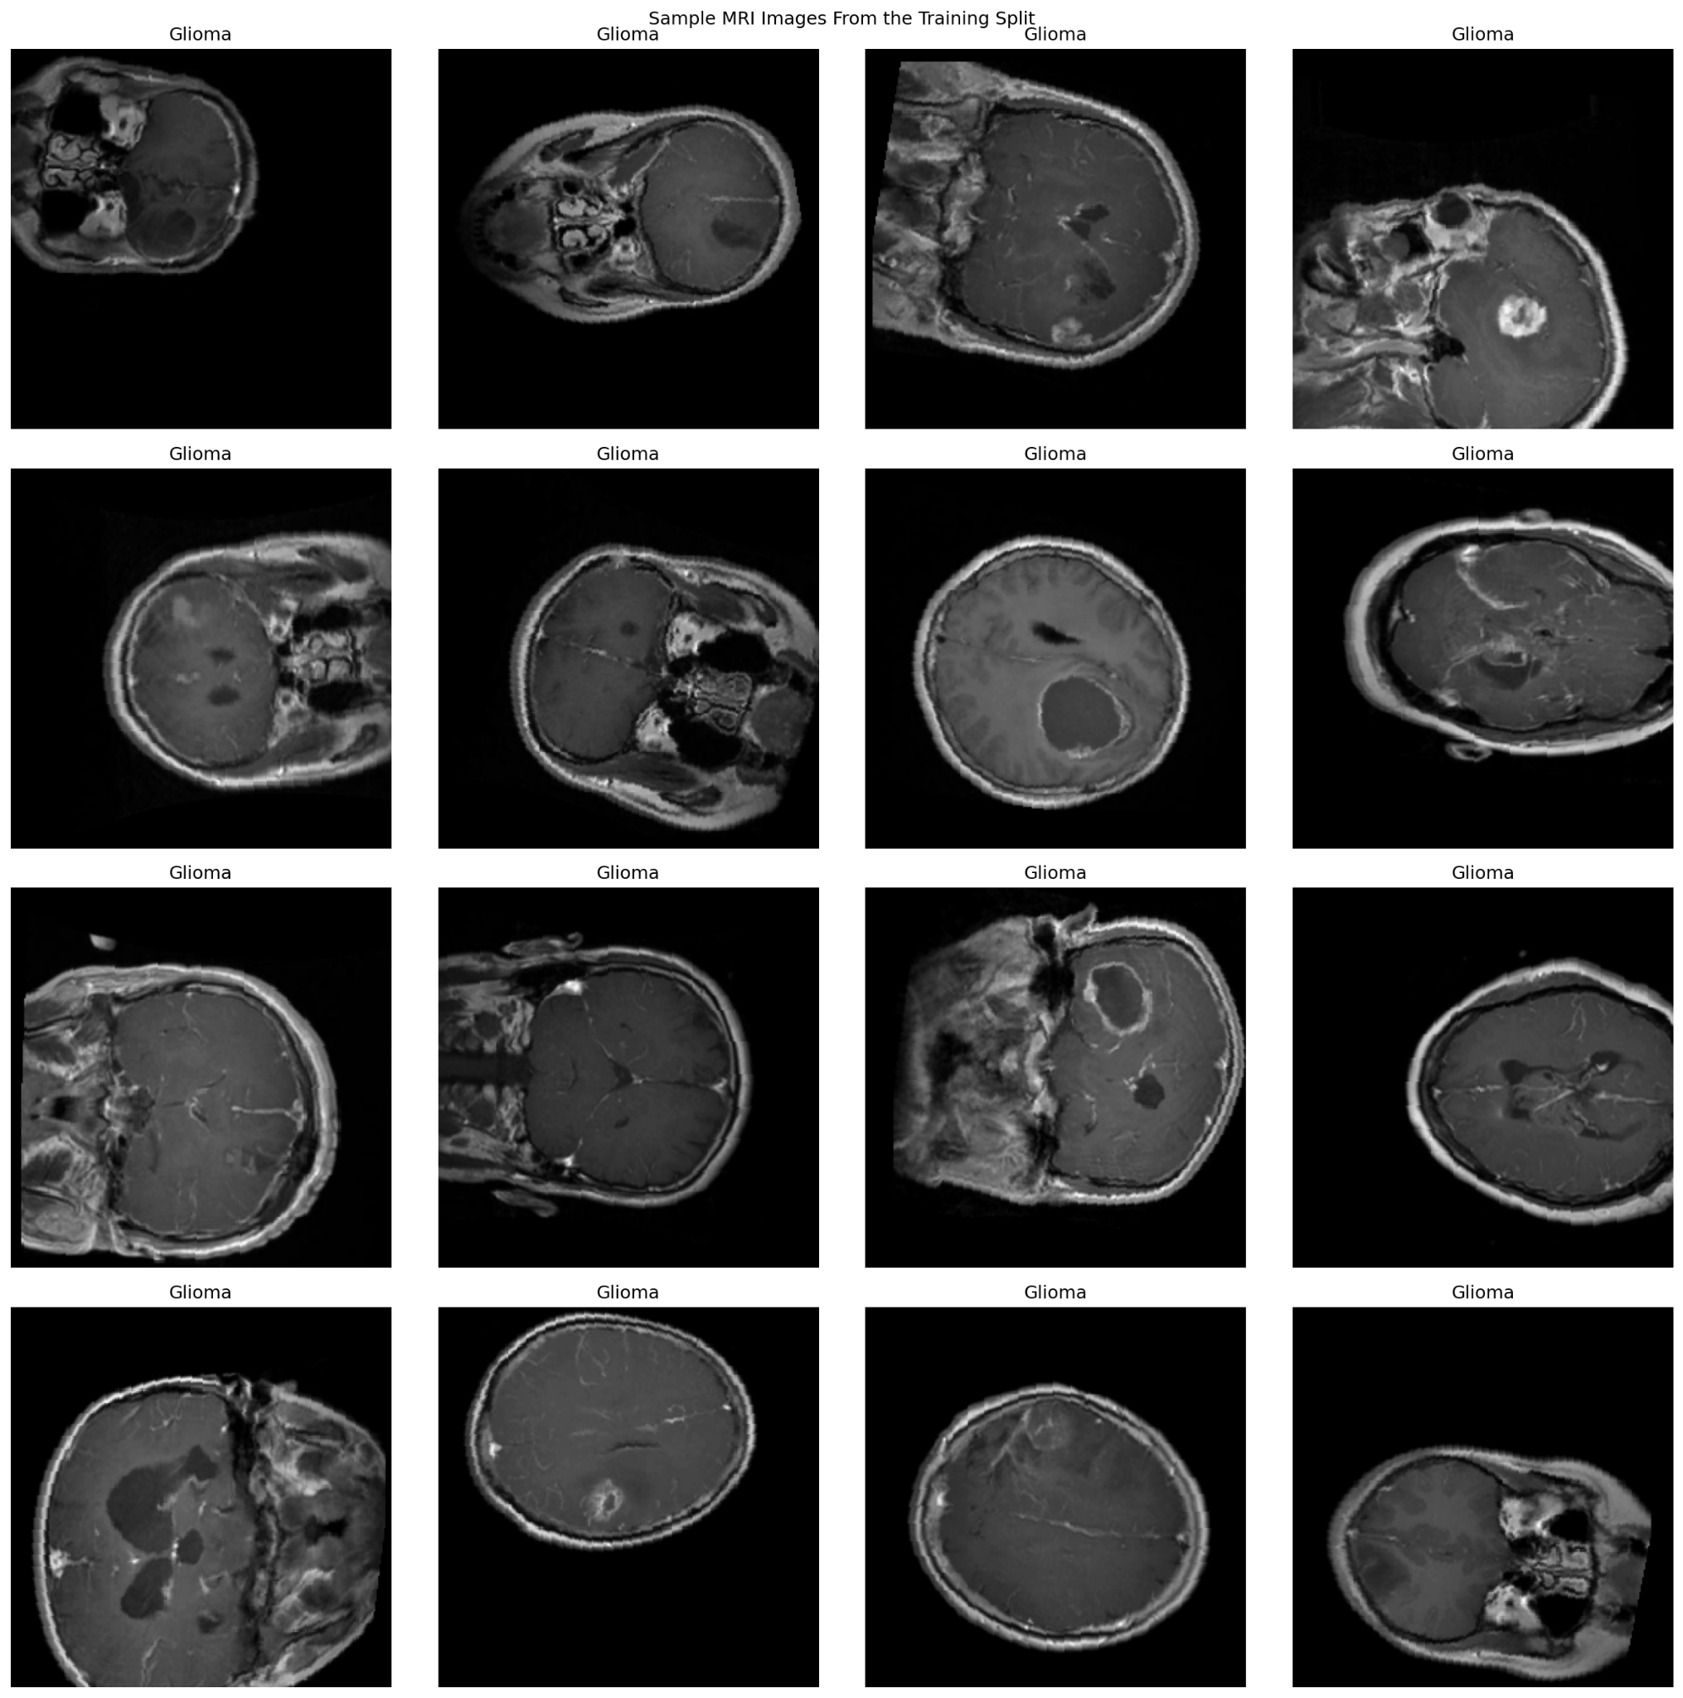
Brain Tumor MRI Classification Model
Final Project – MPHY 6120 AI in Medicine
Nehemyah Green, Ledi Anggara, Trent Levy
Apr 29, 2026
Notes:
Title slide. Introduce the model as a support tool for classifying brain tumor MRI slices into glioma, meningioma, and pituitary tumor. Emphasize this is a review board presentation, not a claim for autonomous diagnosis.
Final Project – MPHY 6120 AI in Medicine
Nehemyah Green, Ledi Anggara, Trent Levy

Slide 2
THE PROBLEM
The Clinical Need
The tool is designed to support image review, not replace clinical interpretation.
Clinical need
Glioma, meningioma, and pituitary tumors can require different clinical management.
MRI review depends on expert interpretation and can vary with image quality, slice selection, and reader experience.
A consistent AI second reader may help triage cases, support education, and provide an additional check during review.
Representative MRI slices from the training split
Section 1 of 5 | The Problem
Brain tumor MRI classifier | Review board presentation
Notes:
1 min
Problem slide. Keep it clinical. Explain that the issue is not only whether AI can classify images, but whether it can do it in a way that is consistent, transparent, and safe enough to be useful in workflow.
Clinical framing:
The safest intended use is decision support: the model can suggest a tumor class and show visual evidence, while the final decision remains with the clinician.

Slide 3
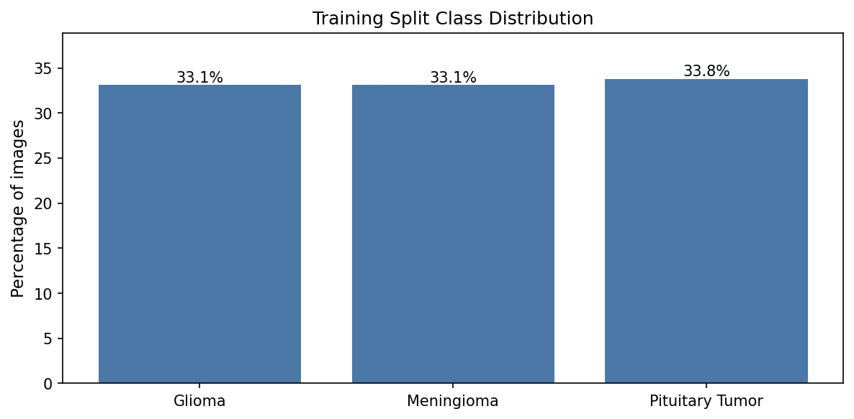
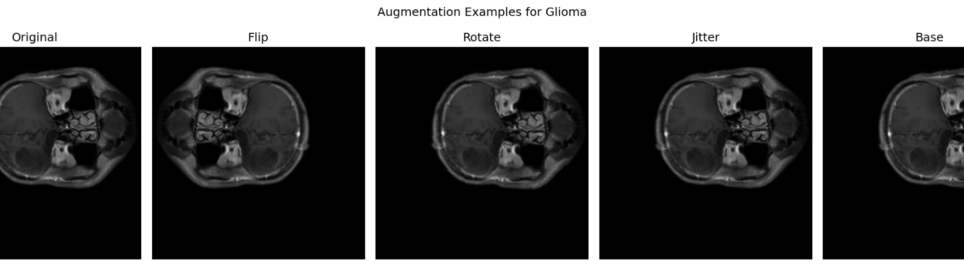
DATA & APPROACH
Dataset
Single 2D MRI slices were used to build and evaluate a three-class classifier.
4,239
908
909
3
training images
validation images
test images
classes
Data decisions
Training split class distribution
Classes: glioma, meningioma, and pituitary tumor.
Dataset was deduplicated.
Images were normalized and resized for model input.
Augmentation was used to reduce overfitting and teach the model to ignore small acquisition differences.
Evaluation was performed on a held-out test set.
Examples of augmentation applied to training images
Section 2 of 5 | Data & Approach
Brain tumor MRI classifier | Review board presentation
Notes:
1.5 MIN
Data slide. Mention that the dataset appears balanced across classes, which makes overall accuracy easier to interpret. Explain augmentation simply: small image changes used during training so the model does not memorize exact images.

Slide 4
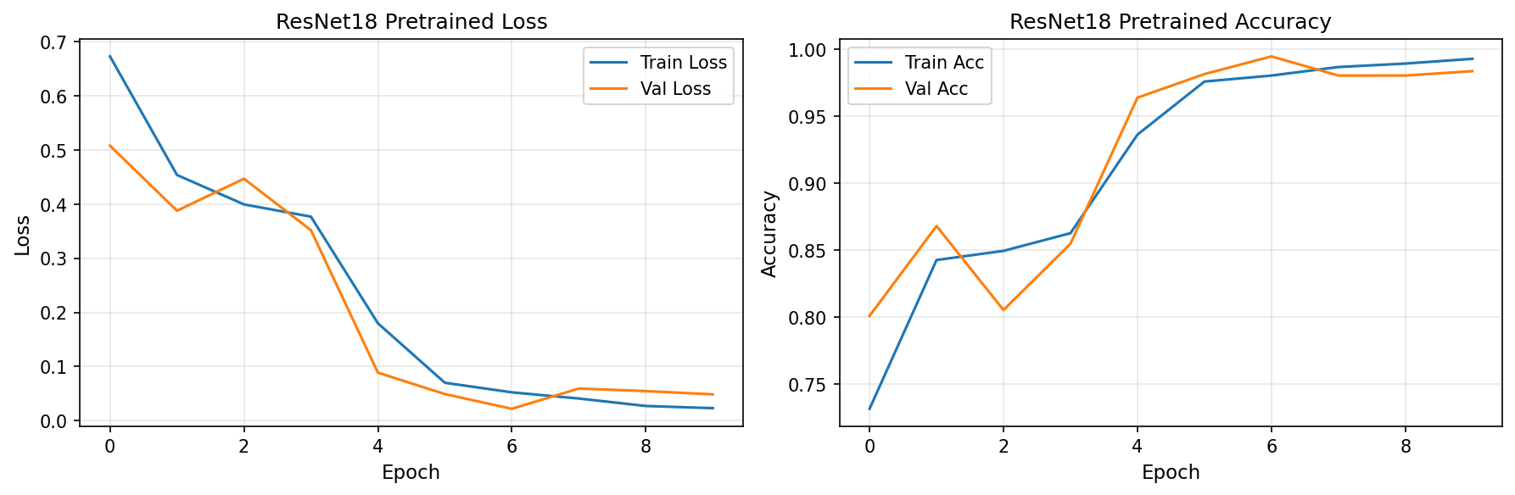
DATA & APPROACH
The Model - ResNet18 transfer learning classifier
Technical choices were kept practical: pretrained CNN, limited training time, and multiple explanation checks.
MRI slice
Preprocess + augment
ResNet18 pretrained
Class + confidence
Training and validation curves
Loss -Accuracy Curve for Train and Validation dataset for ResNEt18 Pretrained
Key technical decisions: transfer learning, class-balanced evaluation, confidence calibration review, and two interpretability methods.
Section 2 of 5 | Data & Approach
Brain tumor MRI classifier | Review board presentation
Notes:
1.5 min
Technical approach. Explain transfer learning in plain language: starting from a model that already knows general image patterns, then adapting it to brain MRI tumor classes. Point to training curves: loss decreases and accuracy increases without major divergence.

Slide 5
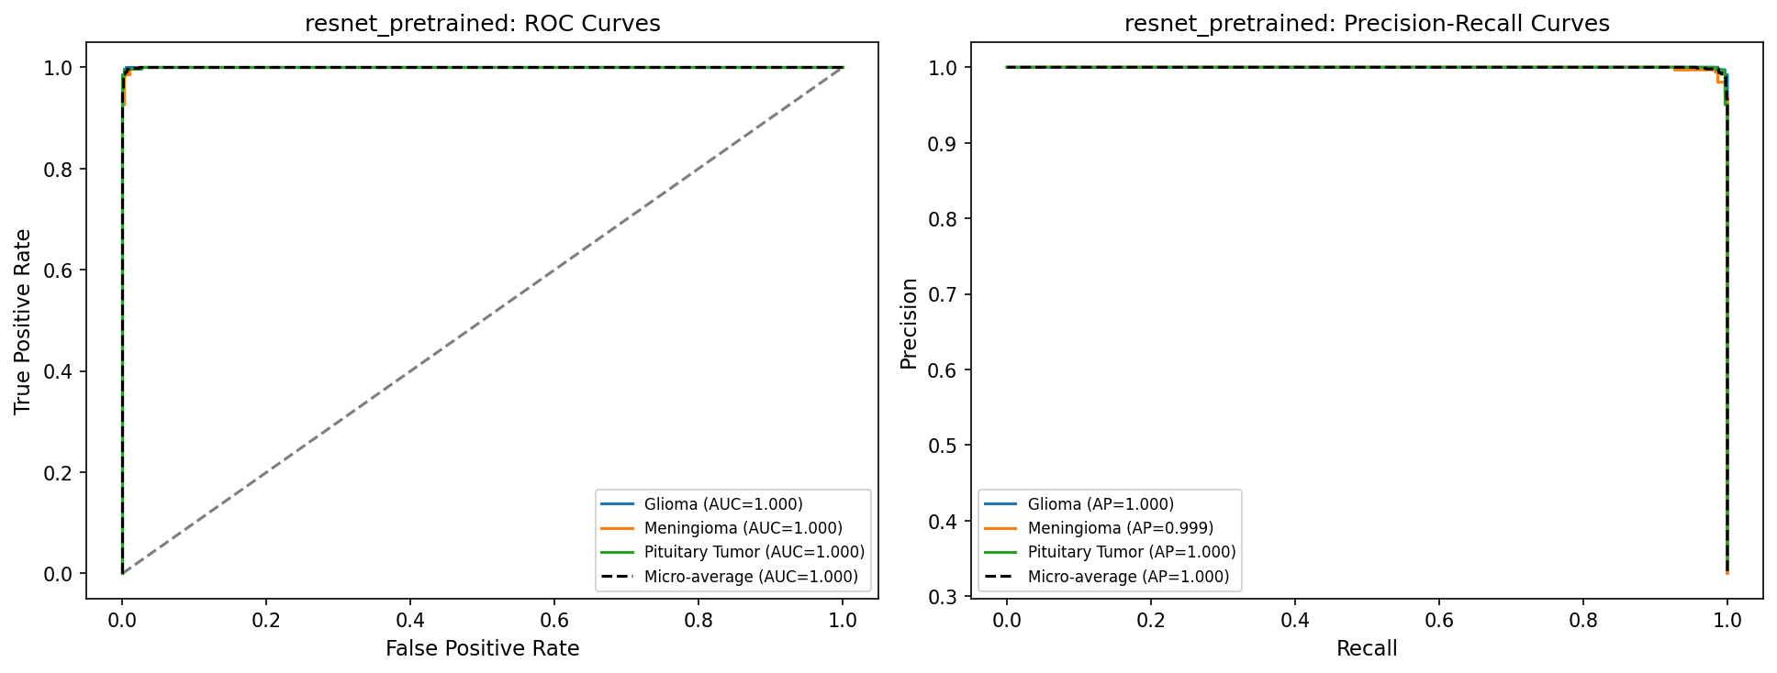
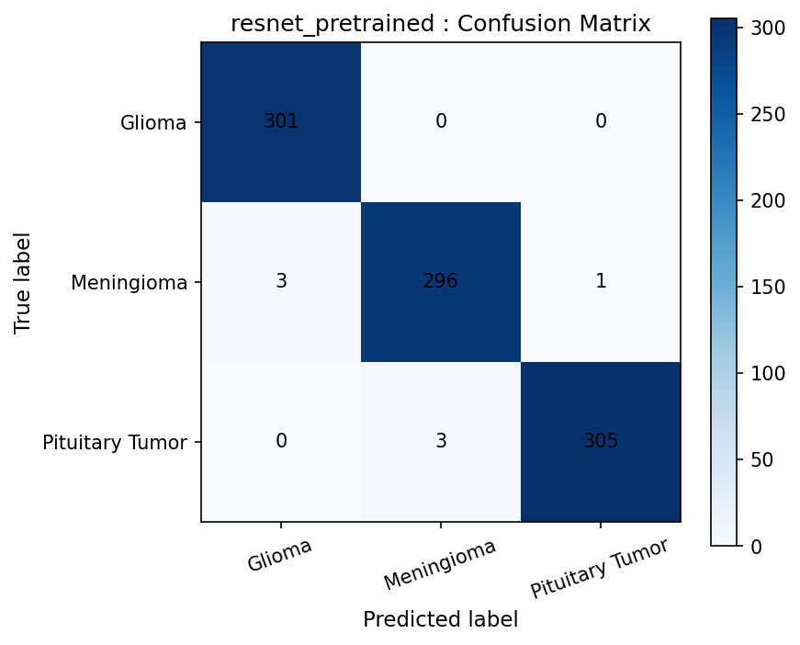
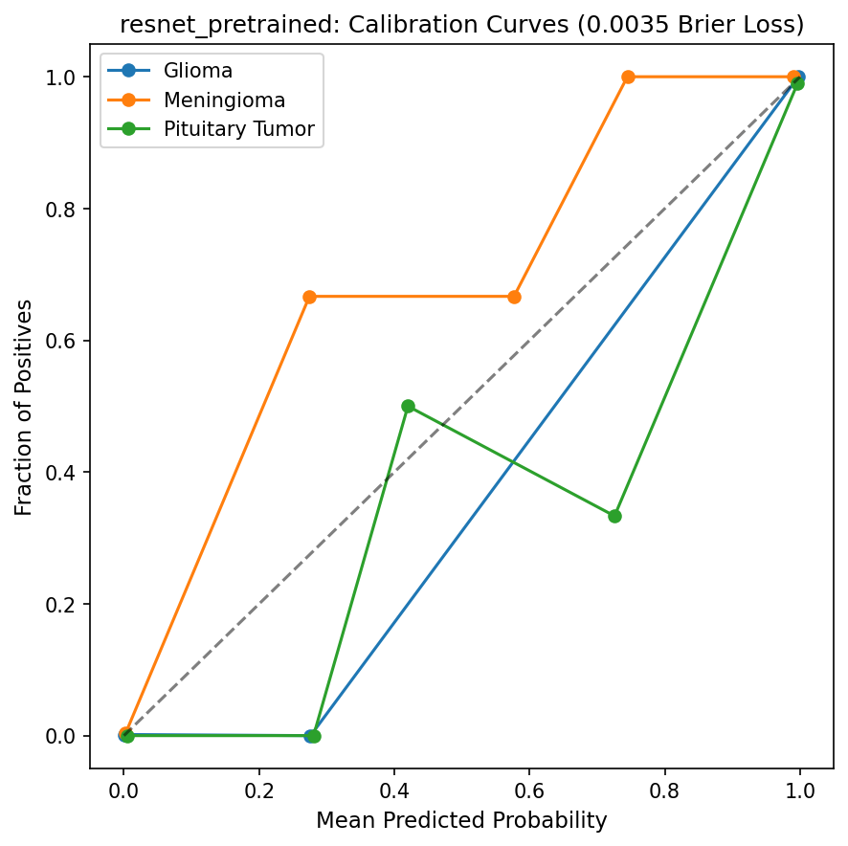
RESULTS
Test Performance
The model performed well on the internal test set, but errors cluster around meningioma cases.
0.99
1.000
0.0035
Macro Accuracy
ROC-AUC
all classes ≈ 1.00
Brier loss
lower is better
ROC and precision-recall curves
Assessment
Errors are rare but clinically meaningful.
Confidence is often very high, so calibration must be monitored.
External validation is still required.
Confusion matrix on held-out test set
Calibration curve
Section 3 of 5 | Results
Brain tumor MRI classifier | Review board presentation
Notes:
Results slide. State the key numbers clearly: 902 correct out of 909 on the test set. Do not oversell. Emphasize that excellent internal performance does not automatically mean the model is ready for independent clinical deployment.

Slide 6
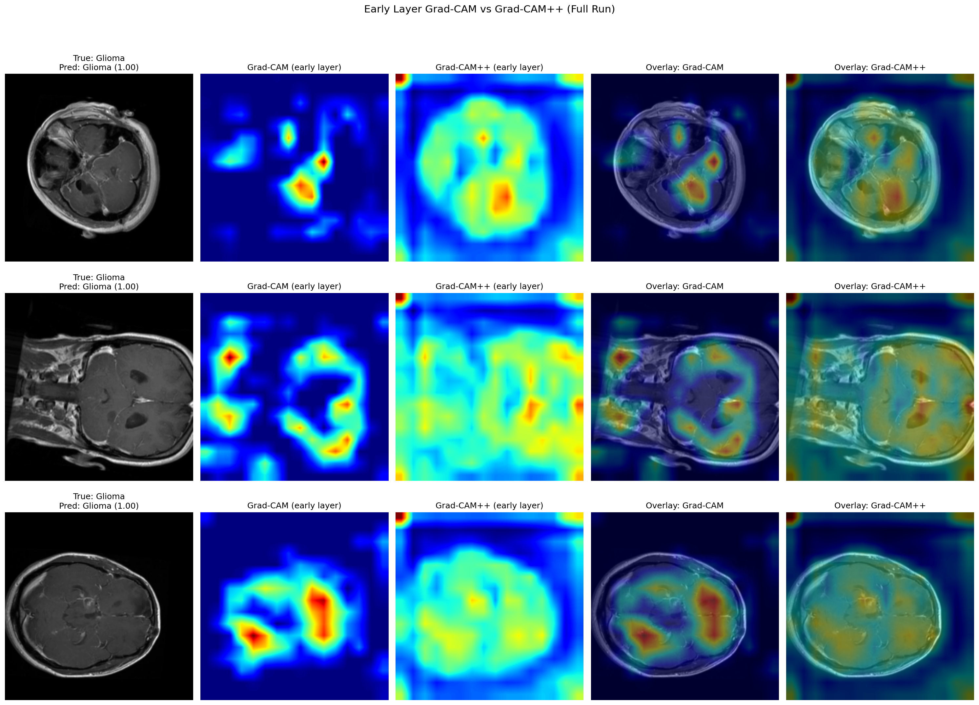
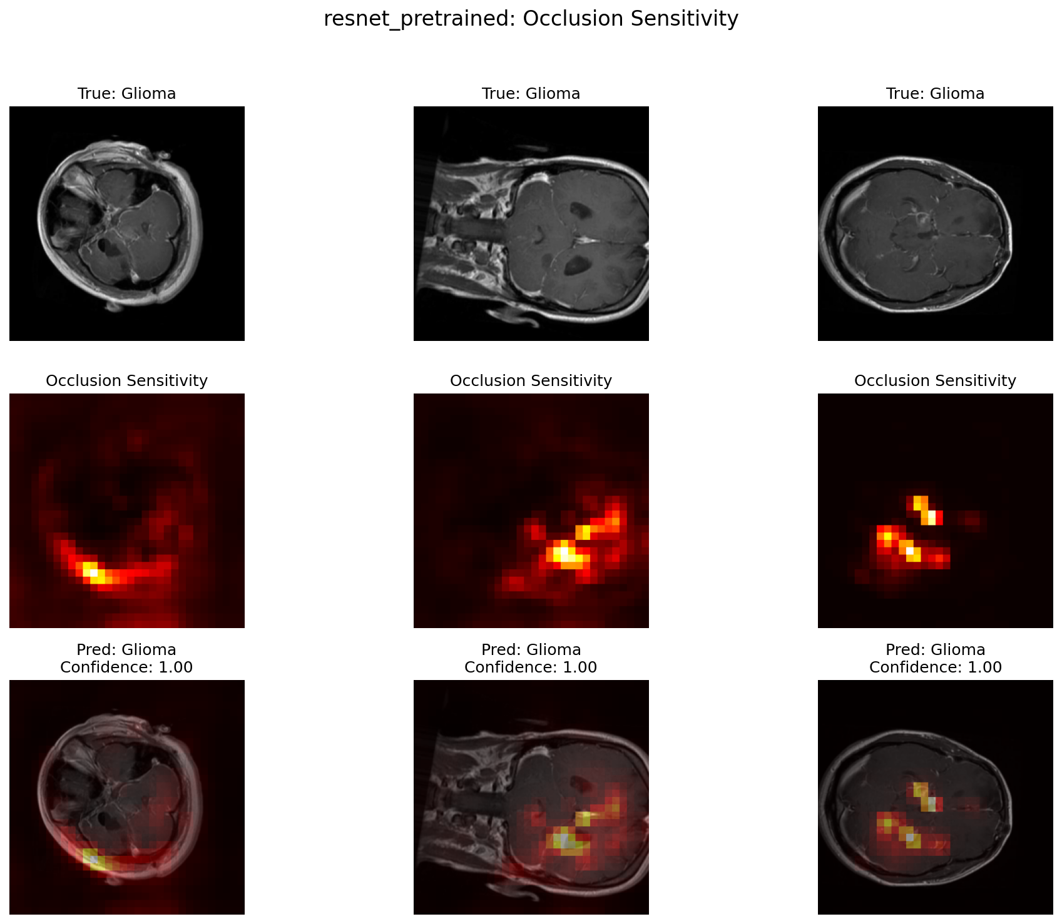
RESULTS
Interpretability
Grad-CAM and occlusion were used to test whether the model looked at clinically reasonable regions.
Occlusion sensitivity examples
Grad-CAM / Grad-CAM++ comparison
Grad-CAM on test dataset
Occlusion on test dataset
Section 3 of 5 | Results
Brain tumor MRI classifier | Review board presentation
Notes:
Interpretability slide. Explain that heatmaps are not proof that the model reasons like a physician. They are quality checks. The strongest limitation here is that there were no tumor masks, so localization could not be quantitatively verified.
What looks good: Occlusion maps often localize around tumor-relevant regions.
Multiple visual tools provide cross-checking.
What need caution:
Early-layer Grad-CAM can be diffuse and may include non-tumor anatomy.
No ground-truth masks were available, so Dice/IoU could not be validated.

Slide 7
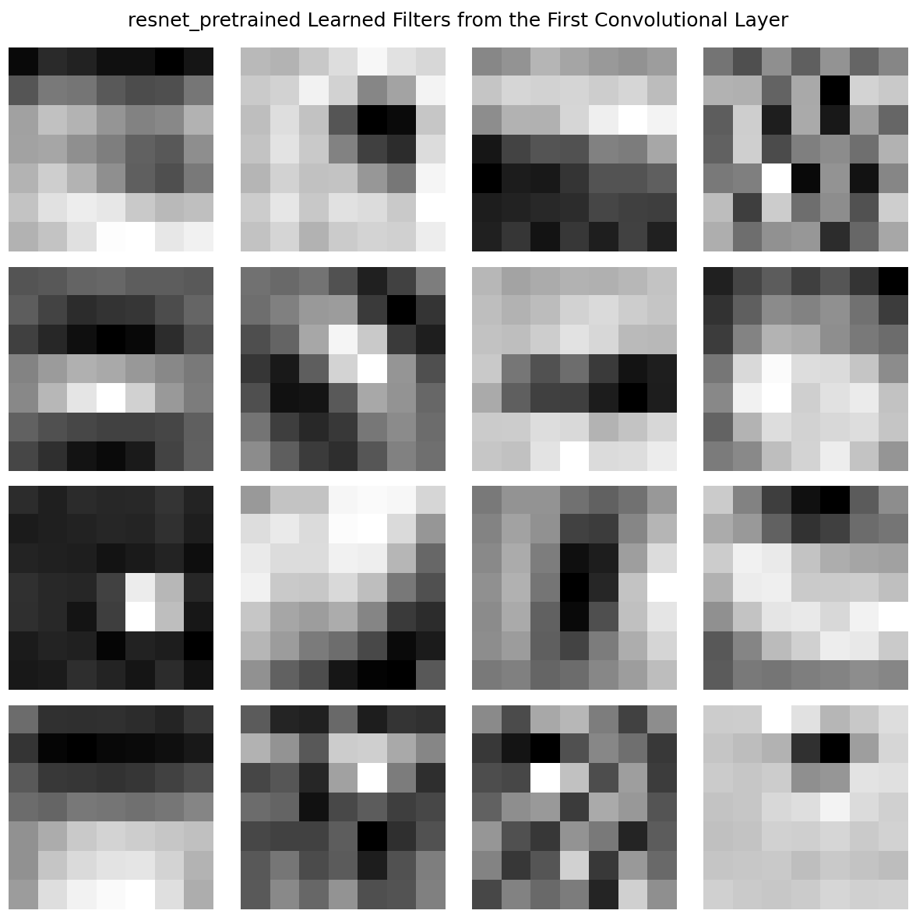
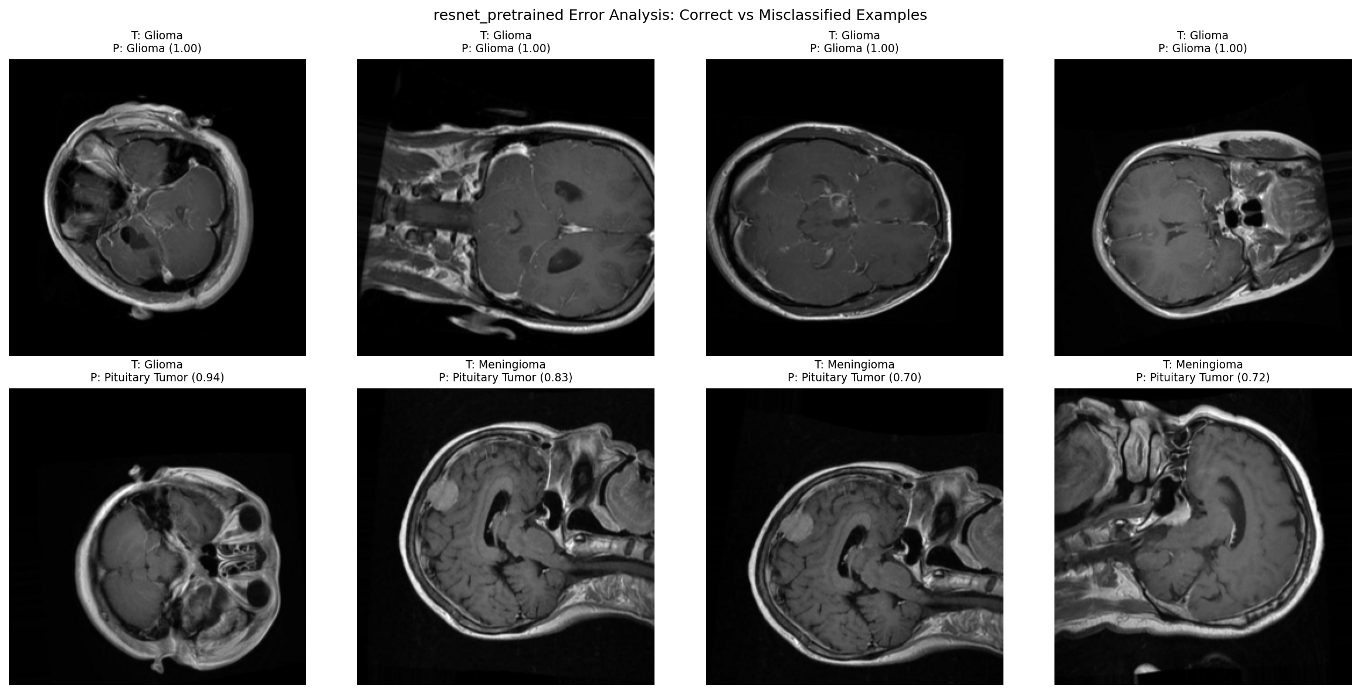
RESULTS
Interpretability
Grad-CAM and occlusion were used to test whether the model looked at clinically reasonable regions.
Filters
Correct vs misclassified examples
Section 3 of 5 | Results
Brain tumor MRI classifier | Review board presentation
Notes:
Interpretability slide. Explain that heatmaps are not proof that the model reasons like a physician. They are quality checks. The strongest limitation here is that there were no tumor masks, so localization could not be quantitatively verified.
What looks good: Occlusion maps often localize around tumor-relevant regions.
Multiple visual tools provide cross-checking.
What need caution:
Early-laer Grad-CAM can be diffuse and may include non-tumor anatomy.
No ground-truth masks were available, so Dice/IoU could not be validated.

Slide 8
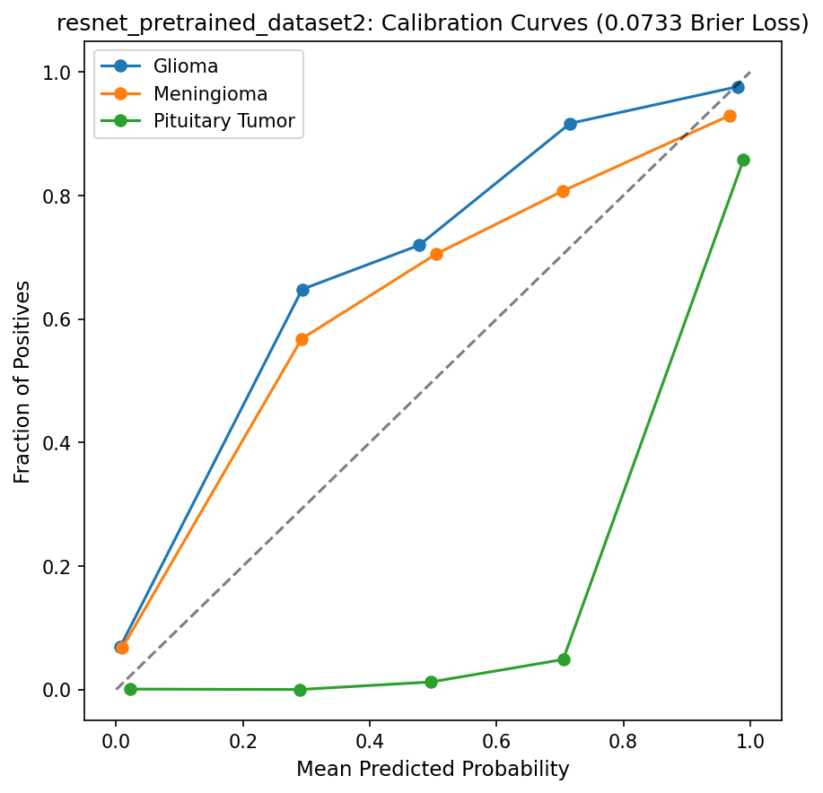
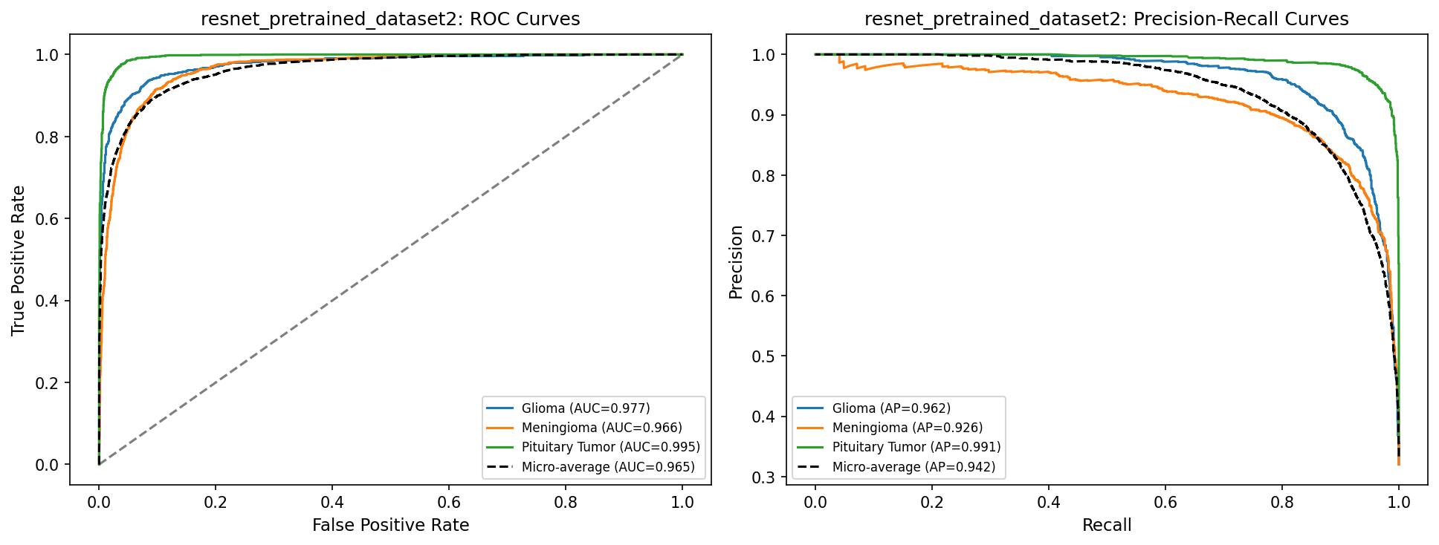
RESULTS
Test Performance – Additional Test Data (Glioma and Meningioma only)
The model performed well on the internal test set, but errors cluster around meningioma cases.
0.86
0.977
0.073
Macro Accuracy
ROC-AUC
all classes ≈ 1.00
Brier loss
lower is better
Calibration curve
ROC and precision-recall curves
Calibration curve
Section 3 of 5 | Results
Brain tumor MRI classifier | Review board presentation
Notes:
The ROC-AUC was approximately 0.977, which means the model was very strong at separating the classes based on its prediction scores.
The macro accuracy was 0.86, meaning that when both classes are considered equally, the model correctly classified most cases. However, the errors were not randomly distributed. Most of the misclassifications clustered around meningioma cases, which is important because it tells us where the model is less reliable.
I also looked at calibration using the calibration curve and Brier loss. The Brier loss was 0.073, where lower is better. This suggests that the model’s predicted probabilities were reasonably good, but calibration still matters because a highly accurate model can still be overconfident.
So overall, the pretrained ResNet18 model showed strong performance, but the error pattern shows that we still need careful review, especially for meningioma cases.

Slide 9
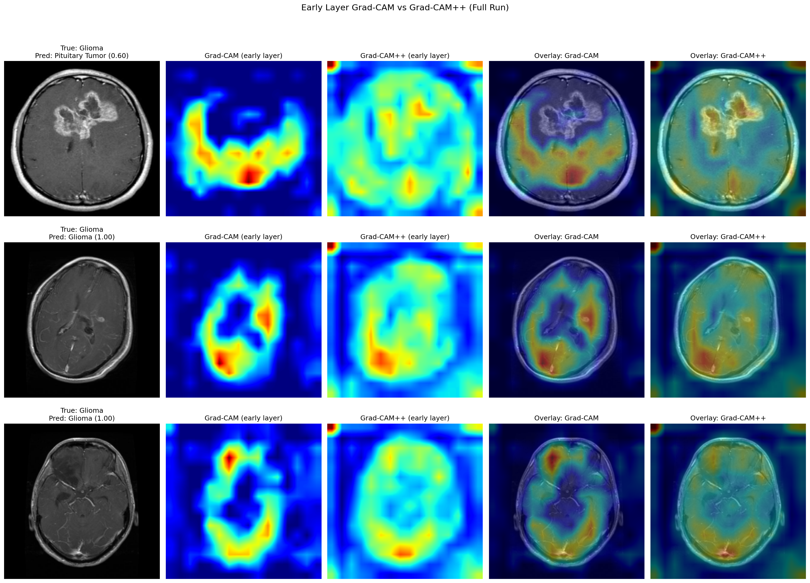
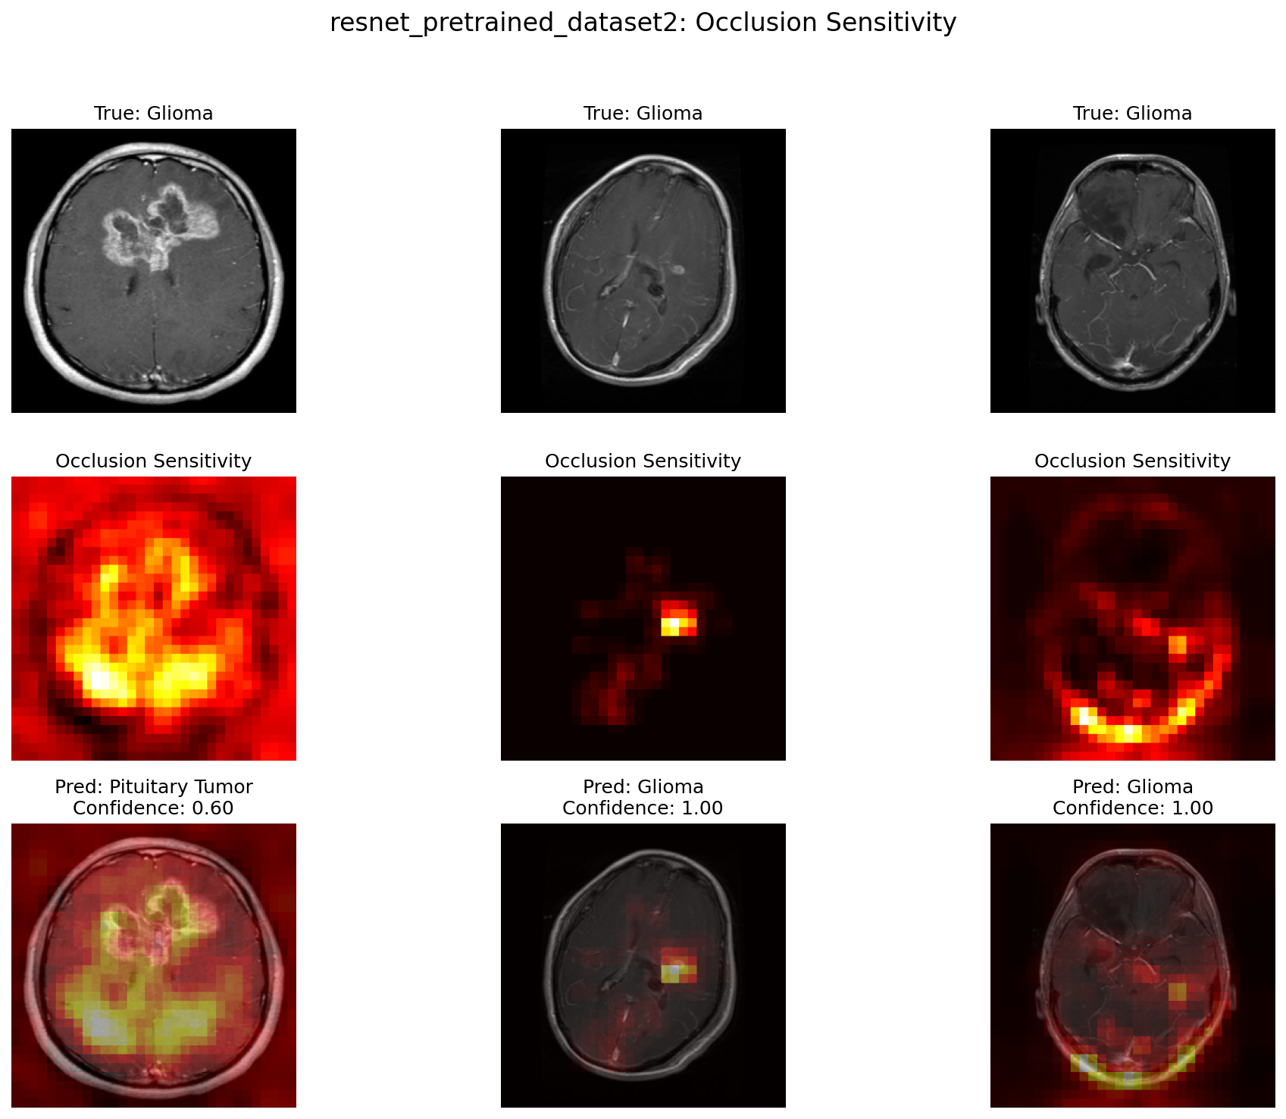
RESULTS
Interpretability
Grad-CAM and occlusion were used to test whether the model looked at clinically reasonable regions.
Occlusion sensitivity examples
Grad-CAM / Grad-CAM++ comparison
Grad-CAM on test dataset
Occlusion on test dataset
Section 3 of 5 | Results
Brain tumor MRI classifier | Review board presentation
Notes:
After evaluating performance, I used interpretability methods to better understand how the model was making its predictions.
Specifically, I used Grad-CAM, Grad-CAM++, and occlusion sensitivity. These methods do not prove that the model is clinically correct, but they help us check whether the model is focusing on reasonable image regions.
Grad-CAM highlights the regions that contributed most strongly to the model’s prediction. Grad-CAM++ is a variation that can sometimes provide more detailed localization. Occlusion sensitivity works differently: it blocks parts of the image and checks how much the prediction changes.
If blocking a region causes the confidence to drop, that region may be important for the model’s decision.
In this slide, the main purpose is to show that the pretrained ResNet18 model was not evaluated only by accuracy. I also wanted to inspect whether the model appeared to focus on tumor-related regions rather than irrelevant background or image artifacts.

Slide 10

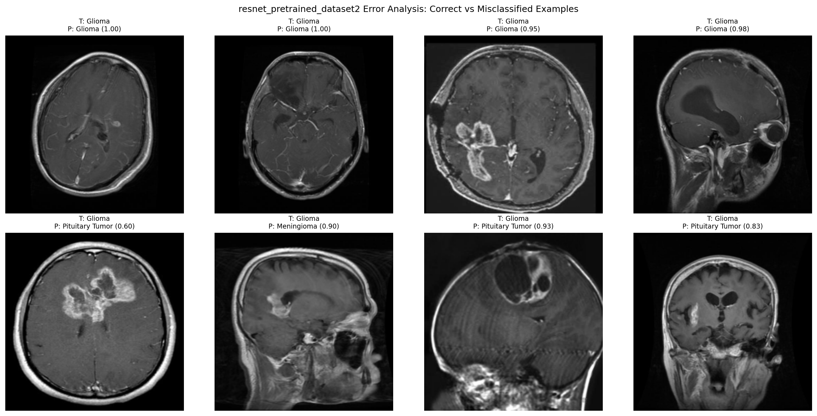
RESULTS
Interpretability
Grad-CAM and occlusion were used to test whether the model looked at clinically reasonable regions.
Filters
Correct vs misclassified examples
Section 3 of 5 | Results
Brain tumor MRI classifier | Review board presentation
Notes:
Here, I compared examples of correct and incorrect predictions.
This step is important because summary metrics alone can hide clinically meaningful failure patterns. A model can have high overall accuracy but still fail in specific situations.
For the correct predictions, the heatmaps generally appeared more consistent with clinically meaningful regions. For the misclassified examples, the model attention may be less specific or may include areas that are not clearly related to the tumor.
This supports one of the main lessons from the project: interpretability tools are helpful for model review, but they should not be treated as ground truth. Grad-CAM and occlusion only show what influenced the model, not whether the model is truly reasoning like a radiologist.
So these examples are useful for error review, but final interpretation would still require expert clinical review.

Slide 11
FIELD GUIDE HIGHLIGHTS
The Governance
1
2
3
4
Acceptance testing
Routine monitoring
Escalation
Human review
Local validation before use
Target: no unexpected performance drop
Track accuracy, confidence, class mix, and failure patterns
Cadence: weekly early, monthly after stable
Pause if accuracy drops >5%, confidence shifts, or heatmaps behave unexpectedly
Clinician confirms, overrides, and documents final decision
Section 4 of 5 | Field Guide Highlights
Brain tumor MRI classifier | Review board presentation
Notes:
For the field guide section, I focused on governance because model performance alone is not enough for safe clinical use.
The first step is acceptance testing. Before a model is used locally, it should be validated on local data to make sure there is no unexpected performance drop. This is especially important because MRI images can vary across scanners, institutions, and protocols.
The second step is routine monitoring. After deployment, we would need to track accuracy, confidence scores, class distribution, and failure patterns. Early monitoring should be frequent, such as weekly, and then monthly after the model becomes stable.
The third step is escalation. The model should be paused or reviewed if accuracy drops by more than 5%, if confidence patterns shift, or if heatmaps start behaving unexpectedly.
Finally, there must be human review. The model should support the clinician, not replace them. A clinician should confirm, override, and document the final decision.
So the key point is that governance is not separate from the model. It is part of the safety system around the model.

Slide 12
FIELD GUIDE HIGHLIGHTS
Limitations define safe boundaries for use
The model should be used only within its validated scope.
Known limitations
Where performance may degrade
Should NOT be used for
Single 2D slice input only.
No clinical history or multi-sequence MRI information.
Internal test performance only; external validation required.
No segmentation masks available for quantitative heatmap validation.
Different scanner vendors or protocols.
Low-quality, cropped, or rotated images.
Uncommon tumor subtypes or postsurgical changes.
Patient populations not represented in training data.
Standalone diagnosis.
Replacing radiology review or pathology.
Treatment planning decisions.
Automated triage without human confirmation.
Section 4 of 5 | Field Guide Highlights
Brain tumor MRI classifier | Review board presentation
Notes:
The first limitation is that the model uses a single 2D MRI slice. In real clinical practice, radiologists review multiple slices and often multiple MRI sequences. So this model has less information than a clinician would normally have.
Second, the model does not include clinical history, symptoms, prior imaging, or pathology information. That means it is only learning from the image input.
Third, the results are based on internal testing. External validation is still needed before considering any clinical pilot.
Another limitation is that there were no expert tumor segmentation masks available. Because of that, the heatmaps could only be assessed qualitatively, not quantitatively compared against tumor boundaries.
Performance may also degrade with different scanner vendors, different imaging protocols, poor image quality, cropped images, rotated images, rare tumor subtypes, postsurgical changes, or patient populations not represented in training.
Because of these limitations, the model should not be used for standalone diagnosis, replacing radiology review, treatment planning decisions, or automated triage without human confirmation.

Slide 13
Conclusion
Conclusion
The most useful lessons came from calibration, error review, and interpretability checks.
Lesson learned
What should do differently
Transfer learning is very effective for small-to-moderate medical imaging datasets.
Calibration and error examples are needed because high accuracy can hide overconfidence.
Grad-CAM is helpful but should not be treated as ground truth.
Governance is part of the model, not an afterthought.
Use full 3D MRI volumes or multiple slices instead of a single slice.
Add clinical metadata and multi-sequence MRI if available.
Collect expert tumor masks for localization validation.
Run external validation on data from a different institution before any clinical pilot.
Section 5 of 5 | Conclusion
Brain tumor MRI classifier | Review board presentation
Notes:
Lessons learned slide. This is your closing argument. The model performs very well, but the mature conclusion is not simply that it works. The conclusion is that the model is promising and that safe implementation depends on validation, monitoring, and clinician oversight.
Close: promising decision-support model, but deployment should be limited to a monitored, human-in-the-loop workflow.

Slide 14
Thank you
Questions and feedback are welcome.
Notes:
Q and A slide. Invite feedback. You can ask the board which deployment setting they would consider safest and what validation evidence they would require.

